Slide 1
Community and Global Health

Slide 2
standards of hygiene, including sanitation of water, waste treatment and the presence of pathogens and disease vectors, varies between global communities; travel warnings provide information to help reduce risk of infection
population density and movement patterns influence the transmission of disease
social behaviour is an important factor in the transmission, spread and persistence of sexually transmitted infections

Slide 3
Standards of Hygiene
Many things can be done to reduce the risk of infection with pathogens
Hygiene reduces the risk of infection, and if infected, it reduces the risk of spreading it to others.

Slide 4
Hygienic Practices
Hygienic practices include:
Washing your hands with soap and warm water
Covering your mouth when you cough and sneeze
Wear gloves when cleaning up blood or other body fluids.
Wipe surfaces with disinfectant to clean them
Use tongs, pliers or tweezers when handling food items or medical items or items with bodily fluids in/on them.
Never share personal items e.g. toothbrush, towels

Slide 5
Mask wearing
Provide an obstacle/barrier to invading airborne pathogens and therefore reduce the risk of getting a disease.
Wearing a mask also diminishes the chance that the wearer will breathe out pathogenic organisms
This reduces the spread of the disease.

Slide 6
Protective Clothing
Protective clothing, gloves and safety glasses are important for health workers and community workers to protect against the spread of bodily fluids or against vectors like mosquitoes.

Slide 7
Mechanical Barriers
The spread of STI’s can be controlled through safe sex practices such as wearing a condom and dental dams (oral sex).
Conducting regular testing if you change sexual partners is important to ensure STI’s are not spread unknowingly.

Slide 8
Sanitation of Water
Today, 2 billion people lack access to safely managed drinking water services and 3.6 billion people lack safely managed sanitation services.
Unsafe hygiene practices are widespread, compounding the effects on people’s health.
The impact on child mortality rates is devastating with more than 297 000 children under five who die annually from diarrhoeal diseases due to poor sanitation, poor hygiene, or unsafe drinking water.

Slide 9
Sanitation of Water- Continued
A person without access to improved drinking water – for example from a protected borehole well or municipal piped supply for instance – is forced to rely on sources such as surface water, unprotected and possibly contaminated wells, or vendors selling water of unverifiable quality.

Slide 10
Sanitation of Water- Continued
For many communities, water sources are usually far from their homes, and it typically falls to women and girls to spend much of their time and energy fetching water, a task which often exposes them to attack from men and even wild animals.
Without improved sanitation – a facility that safely separates human waste from human contact – people have no choice but to use communal latrines or to practise open defecation.

Slide 11
Sanitation of Water- Continued
For women and girls, finding a place to go to the toilet outside, often having to wait until the cover of darkness, can leave them vulnerable to abuse and sexual assault.
In the immediate environment, exposed faecal matter will be transferred back into people’s food and water resources, helping to spread serious diseases such as cholera.
Beyond the community, the lack of effective waste disposal or sewerage systems can contaminate ecosystems and contribute to disease pandemics.

Slide 12
The Ongoing Problem
However, it is often the case that even when people do have knowledge of good hygiene behaviour, they lack the soap, safe water and washing facilities they need to make positive changes to protect themselves and their community.

Slide 13
Waste Treatment
Of the total amount of waste generated by health-care activities, about 85% is general, non-hazardous waste.
The remaining 15% is considered hazardous material that may be infectious, toxic or radioactive.
Every year an estimated 16 billion injections are administered worldwide, but not all of the needles and syringes are properly disposed of afterwards.

Slide 14
Waste Treatment- Continued
Open burning and incineration of health care wastes can, under some circumstances, result in the emission of dioxins, furans, and particulate matter.
Measures to ensure the safe management of health care wastes can prevent adverse health and environmental impacts from such waste including the release of chemical or biological hazards (including drug-resistant microorganisms) into the environment thus protecting the health of everyone.

Slide 15
Different Types of Waste
Infectious waste: waste contaminated with blood and other bodily fluids cultures and stocks of infectious agents from laboratory work, or waste from patients with infections (e.g. swabs, bandages);
Pathological waste: human tissues, organs or fluids, body parts and contaminated animal carcasses;
Sharps waste: syringes, needles, disposable scalpels and blades, etc.;
Chemical waste: for example solvents and reagents used for laboratory preparations, disinfectants, sterilants and heavy metals contained in medical devices and batteries;

Slide 16
Different Types of Waste- Continued
Pharmaceutical waste: expired, unused and contaminated drugs and vaccines;
Cytotoxic waste: waste containing substances with genotoxic properties such as cytotoxic drugs used in cancer treatment and their metabolites;
Radioactive waste: such as products contaminated by radionuclides including radioactive diagnostic material or radio therapeutic materials; and
Non-hazardous or general waste: waste that does not pose any particular biological, chemical, radioactive or physical hazard.

Slide 17
Vector-borne diseases
There are two ways that vector-borne diseases are transmitted:
Mechanical transmission takes place when a vector simply carries pathogenic micro-organisms on their body and transfers them to food, which we then consume. Flies and cockroaches are in this category. Flies like to rest on faecal matter and then may move on to fresh food. They can carry infectious agents through their mouth and on their legs and other body parts. They deposit these agents on ready-to-eat foods and the recipient gets infected if they consume the contaminated food.

Slide 18
Vector-borne diseases continued.
Biological transmission involves the multiplication and growth of a disease-causing agent inside the vector’s body.

Slide 19
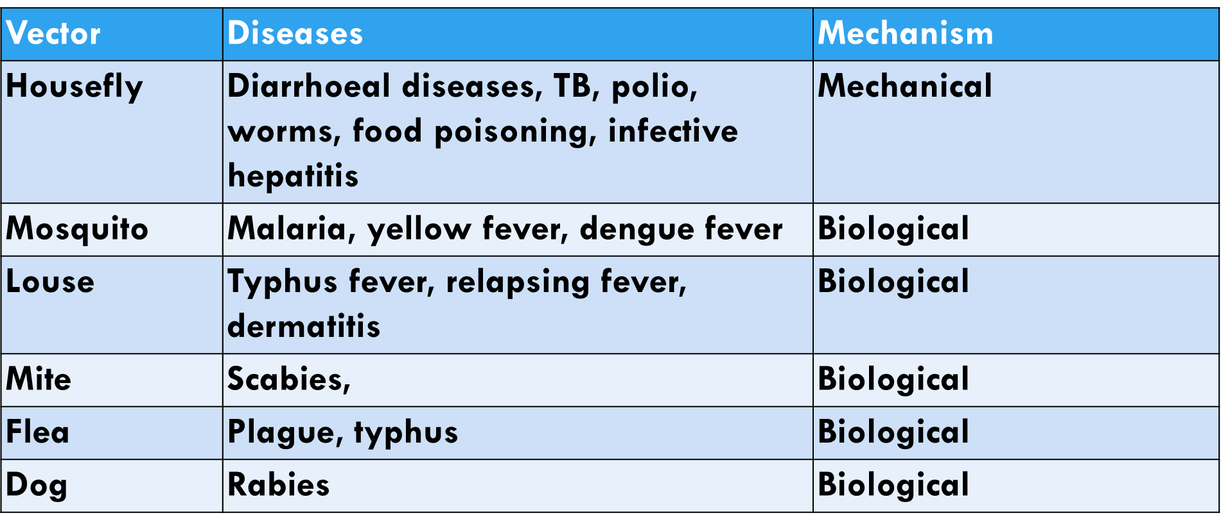

Slide 20
How to control vectors
Basic sanitation:
This approach targets the elimination or reduction of that part of the environment that facilitates breeding and harbourage (places where vectors find refuge or shelter).
It includes the elimination of all possible breeding places for insects, the prevention of stagnation of water to limit the breeding of mosquitoes, and proper solid waste management and use of a latrine to control the breeding of houseflies.

Slide 21
Basic Sanitation continued.
The use of clean water from protected sources for drinking prevents the transmission of parasites. Rats are controlled by starving them and eliminating their breeding places. Personal hygiene contributes to the control of lice.
Generally, a clean home and environment will prevent the breeding of insects. The use of ventilation, latrines and adequate water supply play a significant role in the control of insects.

Slide 22
Control- Physical Measures
These include methods that stop vectors from getting into close contact with humans, and methods that are used to kill vectors.
They include bed nets for mosquitoes and wire mesh for flies and mosquitoes mosquito larvae can be controlled in some water containers by putting a thin layer of used oil on the surface of the water.
Physical methods also include traps for rats and mice. Delousing by boiling or steaming infested clothes are physical methods for controlling lice.

Slide 23
Control- Chemical methods
Chemical insecticides can be used for the destruction of adults and larvae of insects. Commonly used chemicals are DDT, malathion and pyrethrums. Pyrethrum-containing aerosols are used for the destruction of cockroaches and flies in our homes.
Rodenticides can be used to kill rats and mice. The indiscriminate use of these chemicals, however, could have undesired health effects on users and domestic animals.

Slide 24
Control- Biological Methods
These include several very advanced methods that prevent the successful reproduction of pest species. They include the sterilisation of males (tsetse fly, mosquito), sex distortion or replacement of genes.
All of these methods are expensive and often complex to monitor.
Other biological methods involve introducing or encouraging predators of the vector species. For example, small fish can be used to feed on larvae of mosquitoes. Reptiles, birds and frogs feed on adult insects and cats will prey on rats.

Slide 25
https://www.youtube.com/watch?v=2JWku3Kjpq0

Slide 26
Travel Warnings
You can have a higher risk of contracting infectious diseases in some destinations.
This can be due to water and sanitation issues, insects that carry diseases or low vaccination rates. Infectious diseases exist in developed as well as developing countries.

Slide 27
Travel Warnings- Continued
Insects can carry some diseases and transmit them between people. Insects can also transmit some diseases between animals and people.
Australians are more likely to get an insect-borne disease when travelling in tropical climates. This includes parts of Asia, Africa, Central America and the Pacific. Australians are also at risk in parts of Europe and the United States.

Slide 28
Travel Warnings- Continued
For instance, if you're visiting countries where yellow fever is present, you'll have to show a valid yellow fever vaccination certificate to re-enter Australia.

Slide 29
Water or foodborne diseases
These are common in many countries. You can catch them from:
Drinking or using contaminated water
Drinking any drink with ice cubes made with tap water
Eating food washed with tap water
Brushing your teeth or washing your face with tap water
Eating contaminated food
Taking part in activities in contaminated water, such as swimming or water sports

Slide 30
Examples of water and foodborne diseases
Some water and foodborne diseases include:
Infections causing gastroenteritis (vomiting and diarrhoea)
Salmonellosis (including typhoid and paratyphoid)
Hepatitis A
Polio (poliomyelitis)

Slide 31
Transmission of disease movement
Population density and movement of people influence how far the disease spreads and how fast it spreads.

Slide 32
Population density
Density of population does not of itself determine the ease with which infection spreads through a population. Problems tend to arise primarily when populations become so dense as to cause overcrowding.
Overcrowding is often associated with decreases in quality of living conditions and sanitation, and hence the rate of agent transmission is typically very high in such areas.

Slide 33
Population density continued.
Thus, overcrowded cities or densely populated areas of cities can potentially serve as breeding grounds for infectious agents, which may facilitate their evolution, particularly in the case of viruses and bacteria.
Rapid cycling between humans and other hosts, such as rats or mice, can result in the emergence of new strains capable of causing serious disease.

Slide 34
Population movement
Movement into a new environment often is followed by an outbreak of infectious disease.
On pilgrimages and in wars, improvised feeding and sanitation lead to outbreaks of such intestinal infections as dysentery, cholera, and typhoid fever, and sometimes more have died in war from these diseases than have been killed in the fighting.

Slide 35
Social Behaviour
Human behaviours determine outbreak trajectories of infectious diseases.
Mobile-phone data have been a central data source for measuring human behaviour and more specifically, movement.

Slide 36
Social Behaviour- continued
They link phone usage and health records and compare geographically paired, clinically confirmed diagnoses with people who did not receive a diagnosis.
Their approach does not require app download, opt in, symptom reporting, or factors that can impose additional biases on participants.

Slide 37
https://www.youtube.com/watch?v=D28I2mwUOyQ

Slide 38
The Spread and Persistence of STIs
More than 30 different bacteria, viruses and parasites are known to be transmitted through sexual contact.
STIs are spread predominantly by sexual contact, including vaginal, anal and oral sex. Some STIs can also be spread through non-sexual means such as via blood or blood products.
Many STIs (including Syphilis, Hepatitis B, HIV, Chlamydia, Gonorrhoea, Herpes, and HPV) can also be transmitted from mother to child during pregnancy and childbirth.

Slide 39
Prevention of STIs
Prevention of STIs comes with a two tiered approach:
Change behaviour and education
Increase use of barrier methods (e.g. Condoms)

